Slide 1
“The AI Revolution in Healthcare"
Transforming Diagnosis, Treatment, and Patient Outcomes
Notes:
Good morning/afternoon. Today, we're diving into one of the most exciting frontiers in medicine: Artificial Intelligence. We'll explore how AI is not just a futuristic concept, but a practical tool saving lives and improving care right now.

Slide 2
Our Journey Today
• What is AI in Healthcare?
• Key Application Areas :More Than Just Robots,A Second Pair of Eyes: Diagnostics
• Interactive Scenario: The Diagnostic Dilemma What Do You Do?
• Benefits & The Human Touch
• Ethical Considerations
The Future is a Partnership
Q&A
Next
Notes:
Here’s our roadmap. Notice we have an interactive scenario later where you can test your knowledge. You can always return to this agenda using the 'Home' button at the bottom.

Slide 3
More Than Just Robots
AI involves machines performing tasks that typically require human intelligence.
In healthcare, this means:
• Machine Learning: Finding patterns in vast datasets (e.g., medical records, genomic sequences).
• Computer Vision: Analyzing medical images (X-rays, MRIs, retina scans).
• Natural Language Processing (NLP): Understanding and processing clinical notes and research papers.
Notes:
AI isn't about replacing doctors. It's about augmenting their capabilities. Think of it as a powerful tool that can process information at a scale and speed impossible for humans.

Slide 4
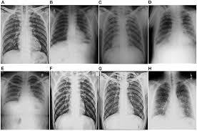
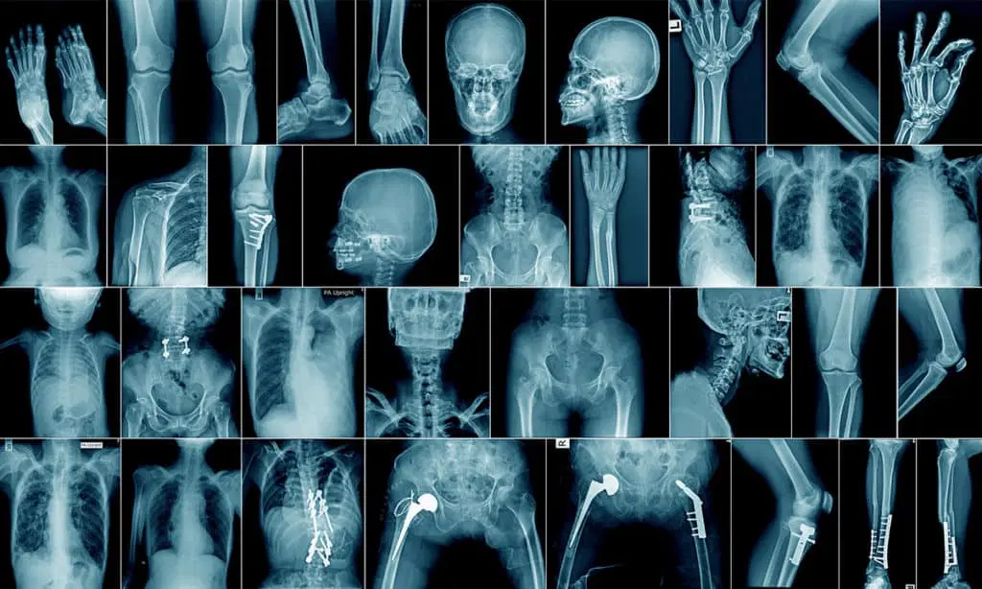
A Second Pair of Eyes: Diagnostics
Traditional Method
A traditional X-ray uses a beam of high-energy electromagnetic radiation to pass through the body, with a device like photographic film or a digital sensor on the other side capturing the X-rays that pass through.
AI-Assisted Method
AI algorithms can detect diseases like cancer, diabetic retinopathy, and neurological conditions from images, often with equal or greater accuracy than human experts.
Notes:
For example, AI systems are now FDA-approved to help radiologists spot subtle signs of lung cancer or stroke in scans, leading to earlier and more accurate diagnoses.

Slide 5
Accelerating Cures & Personalizing Treatment
Drug Discovery: AI can analyze molecular structures to predict how they will interact with diseases, cutting years off the R&D timeline.
Personalized Medicine: By analyzing a patient's genetics and lifestyle, AI can help predict which treatments will be most effective.
Notes:
This isn't just about efficiency; it's about precision. We're moving away from a one-size-fits-all model to therapies tailored to an individual's unique biology.

Slide 6
The Diagnostic Dilemma: An Interactive Scenario
You are a consulting physician. A scan comes in with a suspicious nodule. What's your next step?
Notes:
Now it's your turn. Let's see how you would handle a real-world scenario. Read the options on the next slide and choose what you think is best.

Slide 7
What Do You Do?
A) Rely solely on your initial diagnosis and proceed.
B) Use an AI diagnostic tool to analyze the scan for a second opinion.
C) Send the patient for immediate, invasive surgery.
Back to Scenario
Continue
Notes:
Go ahead and make a choice. There's no penalty for being wrong—this is a learning experience!

Slide 8
A Valuable Learning Moment
While trusting your expertise (A) is crucial, and surgery (C) may be necessary, acting without all available data can carry risks.
Key Takeaway: The best modern practice combines human judgment with technological augmentation. AI provides a powerful, data-driven second opinion to reduce diagnostic errors.
Try Again!
Continue
Notes:
This highlights a critical point. AI is not about replacing the doctor's decision, but about informing it with the best possible data. Even the best clinicians can benefit from a second pair of 'eyes'.

Slide 9

Excellent Decision!
You've chosen to leverage technology to enhance your clinical judgment.
The AI tool confirms the nodule's high risk and flags two other subtle areas for review you hadn't initially noticed. This collaborative approach leads to a more confident diagnosis and a better-tailored treatment plan for the patient.
Continue
Notes:
Congratulations! This is the model for the future of healthcare: a synergistic partnership between human expertise and artificial intelligence, leading to the best possible outcome for the patient.

Slide 10
The Future is a Partnership
AI will not replace doctors, but doctors who use AI will replace those who don't.
Embracing AI means embracing better, faster, and more compassionate care for all.
Restart
Q&A
Notes:
In conclusion, the AI revolution in healthcare is here. It promises to reduce human error, unlock new cures, and personalize medicine. The goal is not to create autonomous machines, but to empower medical professionals, allowing them to focus more on what they do best: caring for the patient. Thank you.

Slide 11
Q&A / Contact
Presented by: Yash Raj
Email: yashraj@gmail.com
Institution : National University of computer and emerging sciences.
Thank you for your attention!
Notes:
Invite audience questions and provide contact details for further discussion.

